Slide 1
Battle of Neighborhoods
Author: Ibrahim Bishtawi

Slide 2
Where to start a Restaurant in Toronto
Opening a successful restaurant has two main components
Style of restaurant
Location
Style of restaurant can be determined by the owners preference
Location of the restaurant needs neighborhood evaluation to see if the restaurant fits in the neighborhood culture

Slide 3
Data Acquisition and Cleaning
Toronto neighborhood data was acquired from Wikipedia source https://en.wikipedia.org/wiki/List_of_postal_codes_of_Canada:_M
Geographic location of each neighborhood was obtained from http://cocl.us/Geospatial_data
The restaurant categories was obtained by using Foursquare application
After cleaning the data we received 89 neighborhoods and 88 restaurant categories

Slide 4
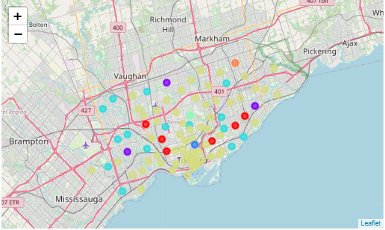
Restaurant Clusters
The neighborhoods are clustered based on neighborhood categories
We will focus on the Bakery Cluster category

Slide 5
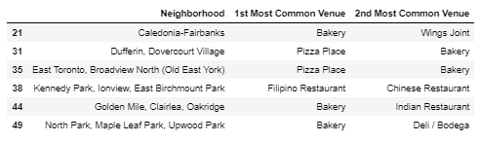
Bakery Cluster
There are 5 main neighborhoods in Toronto that specialize in Bakery products
We will look into Dufferin

Slide 6
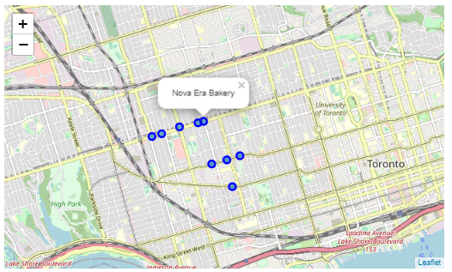
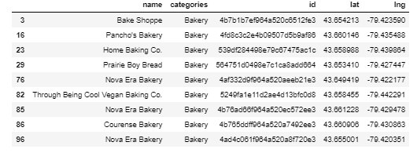
Dufferin Neighborhood
Dufferin has 9 bakeries
3 owned by the same bakery
The 9 bakeries are located in 3 Streets

Slide 7
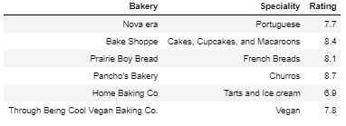
Dufferin Bakeries
Each bakery Specializes in certain category
I would like to start an Arabian Bakery in the region
There are 3 highly rated bakeries and 6 decent bakeries

Slide 8
Conclusion
The neighborhood seems like a good place to start an Arabian sweet bakery.
There are no Arabian bakeries in the region. However there are Middle Eastern Restaurants in the area.
We will need to investigate in depth to see if the neighborhood residents would be interested in Arabian sweets

